Slide 1
Analysis Model
Book Reference: 8.3, 8.6, 8.8

Slide 2
Data Model: Entity Relationship Diagram (ERD)

Slide 3
Elements of ERD:
Entity
Relationship
Cardinality
Modality

Slide 4
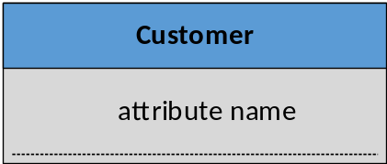
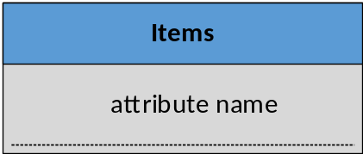
1. Entity:
Something that is described by a set of attributes (data items) and that will be manipulated within the software (system).

Slide 5
Typical Entities:
External entities (user, organizations, devices etc.)
Things (Reports, Signals, Displays)
Roles
Places
Structures or records

Slide 6
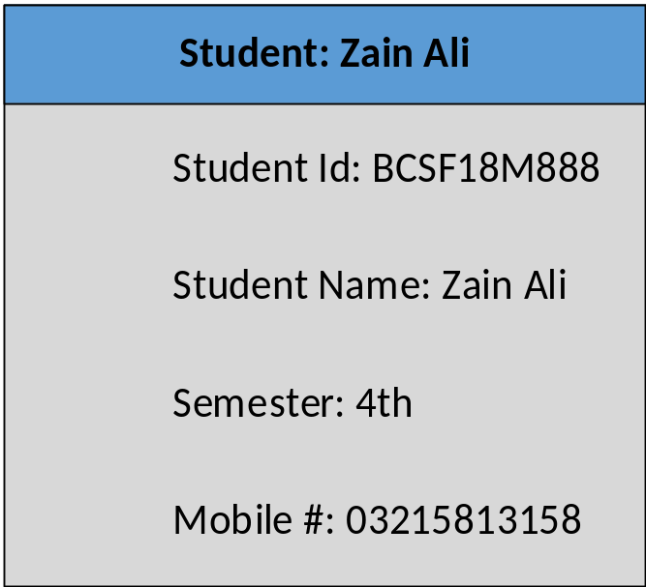
Instance and Attributes:
An instance contains physical value of all attributes that act as an aspect, quality, characteristic, or descriptor of the entity.

Slide 7
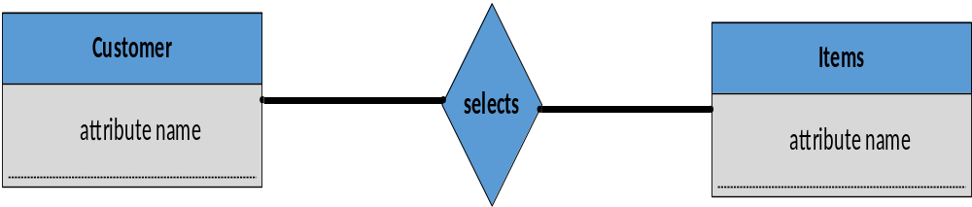
2. Relationship:
“Relationship indicates type of ‘connectedness’ between two entities.”

Slide 8


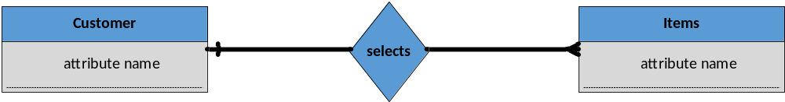
3. Cardinality:
‘Cardinality’ indicates number of instance/s created against other’s entity’s one instance.
  One to One
  One to Many

Slide 9


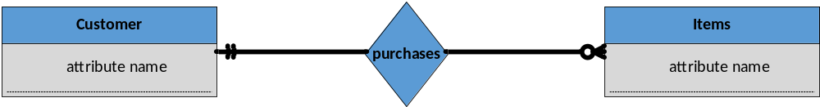
4. Modality:
‘Modality’ indicates whether it is mandatory or optional to create an instance of entity against other entity’s instance.
  Mandatory
  Optional

Slide 10
Example:
PC Associates is a large, multinational consulting corporation, which uses a number of PCs and software packages in the course of her work. PC Associates needs to maintain the following information about the PCs and software packages its employee uses to do their jobs. For each PC, the computer number, the computer model and manufacturer, and the type of microprocessor needed to be stored. Data for each employee also needed to be stored - such as the employee name, employee number, and phone number. Also for each PC, the inventory tag number, location, computer number and the number of the employee who owns the PC. For each software package, the package number, current cost, type, name and version needed to be stored. Also for each software package installed on a PC, the package number and cost, installation date and inventory tag number needed to be stored.

Slide 11
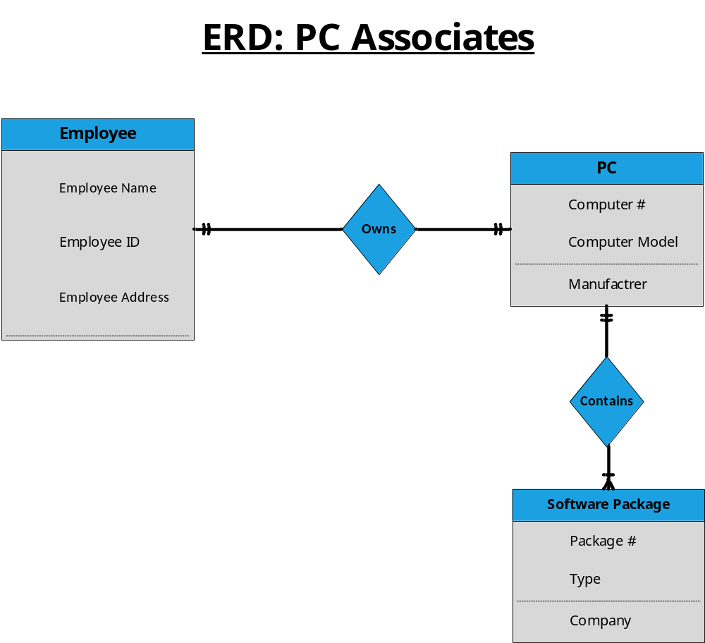

Slide 12
Example:
In a point of sale system, a customer selects items and brings these to sale person. He enters the data of selected items for invoice generation. After generating invoice, it is given to customer. Cash payment is made by customer and transaction is completed.

Slide 13
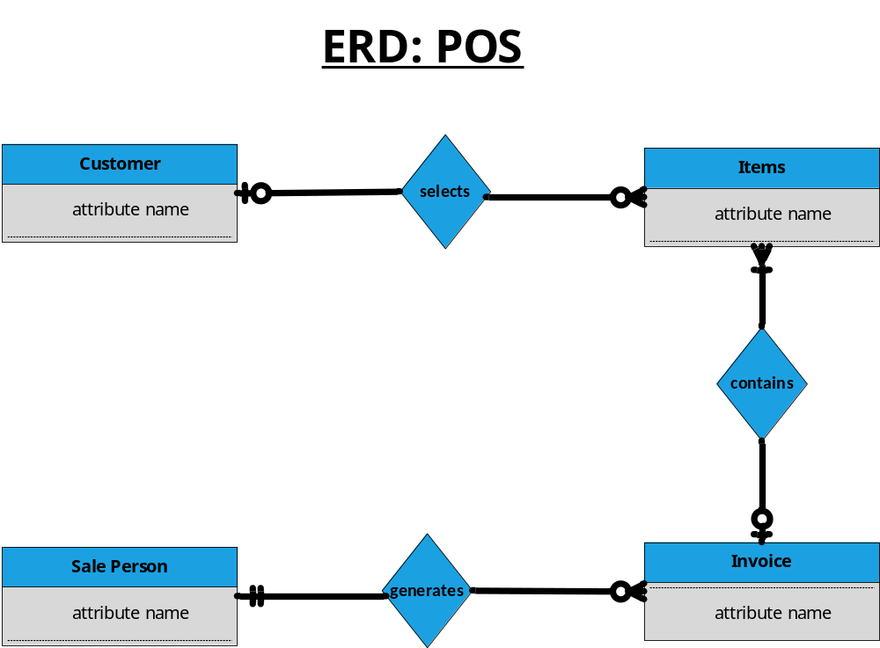

Slide 14
Case study for home work
Scope of “Physician Billing System”:
In the physician billing system, a physician examines a patient and inserts records into system about patient examination. This examination is verified and a valid fee is computed for patient. As the patient is availing the insurance, so he submits an insurance form, which holds all the detail about his insurance policy. It also describes that what amount will be paid by insurance company and what will be paid by the patient. Insurance details inserted are verified by the system. Based on valid fee and insurance form submitted, invoices for patient and insurance company are generated and are sent. Patient and insurance company make payments, which are verified by the system.
Develop ERD for above case study?

